Slide 1
Homework
The Tower of Hanoi
The objective of the puzzle is to move the entire stack to another rod, obeying the following simple rules:
Only one disk can be moved at a time.
Each move consists of taking the upper disk from one of the stacks and placing it on top of another stack or on an empty rod.
No larger disk may be placed on top of a smaller disk.
A
B
C
Animation of 6-disk Tower of Hanoi

Slide 2
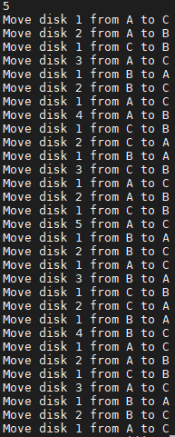
Homework Requirement
Input : a number which is mean how many disk at the first (A) pole.
Output: print the moving process of the disks
the smallest disk is 1, the largest one is N.
and the poles name “A B C” sequentially.
we always want to move all disks from A to C
A
B
C

